Slide 1

Ad_Hoc Insights
Consumer Goods
By K M Dinesh

Slide 2
AGENDA
Company Details and Market
Objectives
Company Platform and Structure
Data,Request and Tools

Slide 3
Company Details andMarket
AtliQ Hardware is a fast-growing company that has expanded its business worldwide. Specializing in computers and accessories, AtliQ has quickly become a global force in the tech industry.
The company offers a wide range of products, including high- performance desktops, laptops, servers, and essential peripherals like keyboards, mice, monitors, and storage devices.
With a strong international distribution network and strategic industry partnerships, AtliQ ensures its products are available to customers everywhere, making it a trusted name in the tech world.
FISCAL YEAR
SEPTEMBER 2019 - AUGUST 2020
FY 2020
SEPTEMBER 2020 - AUGUST 2021
FY 2021

Slide 4
Objectives
AtliqHardware (fictitious corporation) is one of the major computer hardware manufacturers in India, with a strong presence in other nations.
Nevertheless,the management did note that they do not have sufficient insights to make prompt, wise, and data-informed judgments.
Plan to expand the data analytics team by adding junior data analysts.
To assess candidates, Data analytics director, TonySharma plans to conduct a SQL challenge to evaluate both tech and soft skills.
The company seeks insights for 10 ad hoc requests.

Slide 5
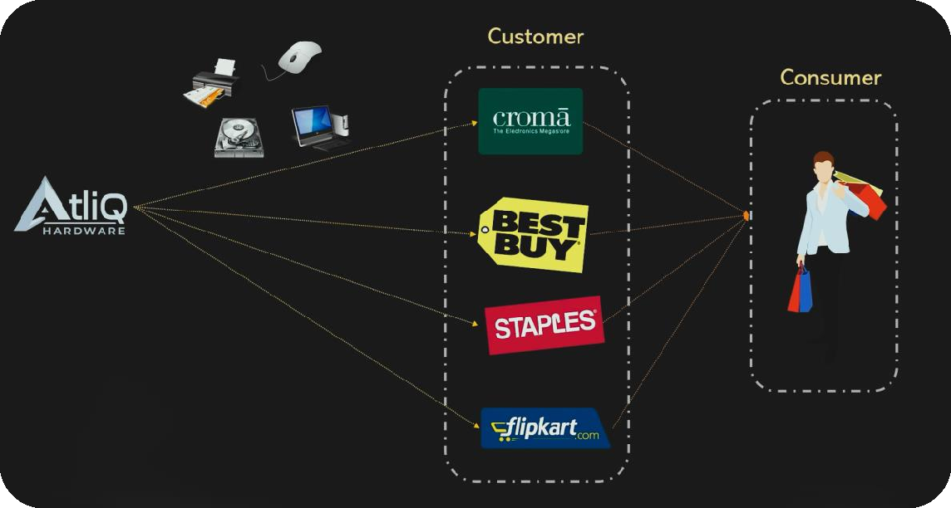
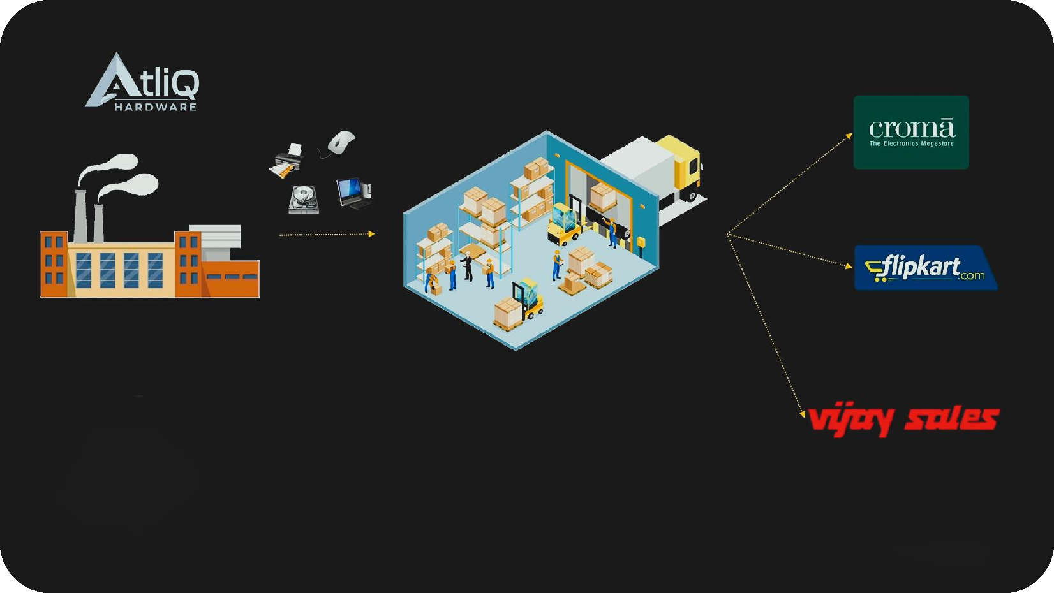
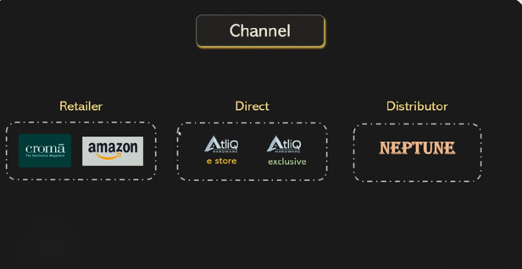
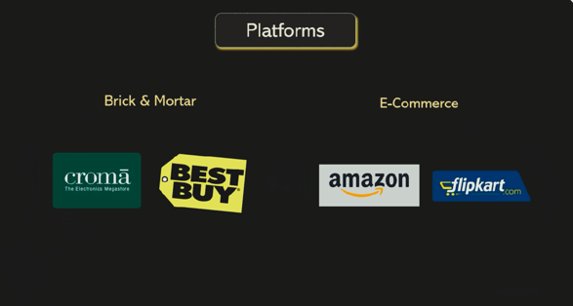
Company Platform and Structure

Slide 6
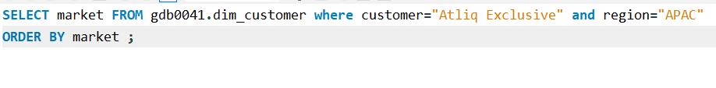
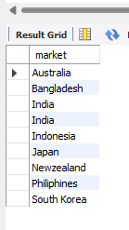
1. Provide the list of markets in which customer "Atliq Exclusive" operates its business in the APAC region.
Insight
In the Asia Pacific Region, “Atliq Exclusive” operates in 8 countries.

Slide 7
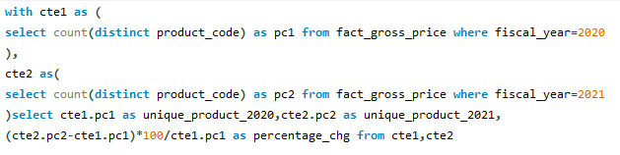
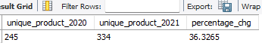
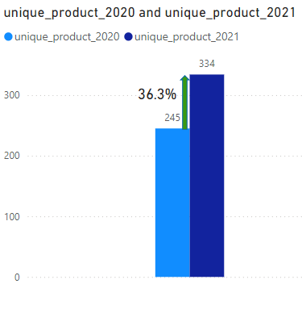
2. What is the percentage of unique product increase in 2021 vs. 2020? The final output contains these fields, unique_products_2020 unique_products_2021 percentage_chg
Insight
In 2020, Atliq Mart achieved sales of 245 products, and in 2021, their sales significantly increased to 334 unique products, marking a substantial growth rate of 36.33%.
It’s a good sign that we are continuously innovating and introducing new products to the market.

Slide 8
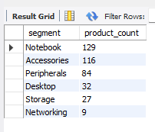
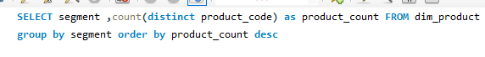
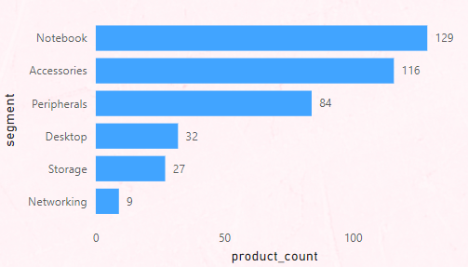
3. Provide a report with all the unique product counts for each segment and sort them in descending order of product counts. The final output contains 2 fields, segment product_count
Insight
The Notebook segment has the highest number of unique products when compared to other segments and the Networking segment has the lowest number of unique products.

Slide 9
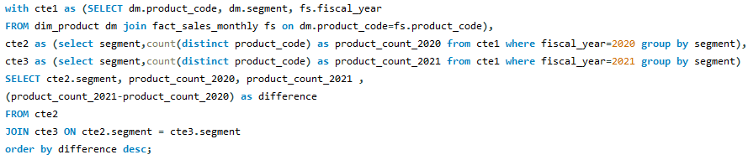
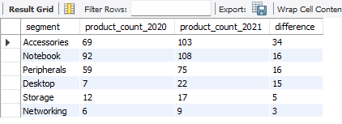
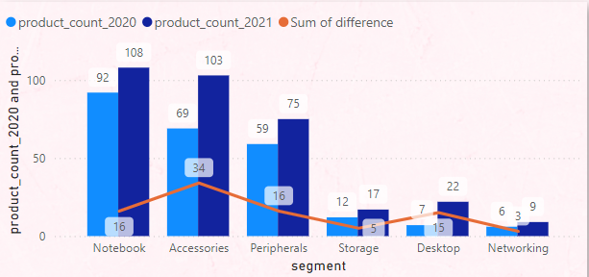
4. Follow-up: Which segment had the most increase in unique products in 2021 vs 2020? The final output contains these fields,. segment product_count_2020 product_count_2021 difference
Insight
Accessories had the largest increase in production.
Storage and networking are experiencing slower production growth than other segments.

Slide 10
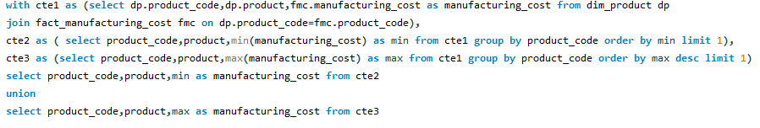
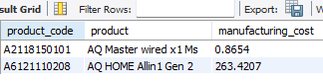
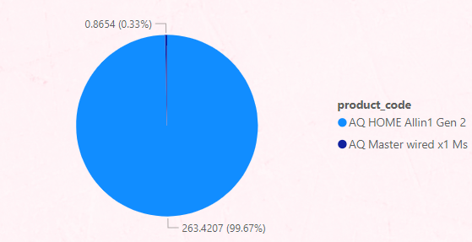
5. Get the products that have the highest and lowest manufacturing costs. The final output should contain these fields, product_code product manufacturing_cost
Insight
Mouse: AQ Master wired x1 Ms (Variant:Standard1) has the lowest manufacturing cost.
Personal Desktop: AQ Home Allin1 Gen2 (Variant:Plus3) has the highest manufacturing cost.

Slide 11
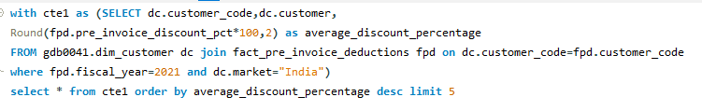
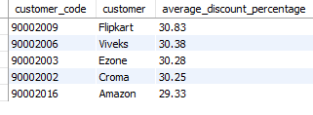
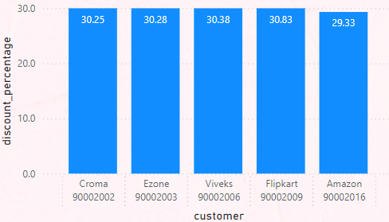
6. Generate a report which contains the top 5 customers who received an average high pre_invoice_discount_pct for the fiscal year 2021 and in the Indian market. The final output contains these fields, customer_code customer average_discount_percentage
Top 5 Indian customers with highest average discount percentage for FY 2021
Insight
In the Indian market for FY 2021, Flipkart has the highest average discount percentage of 30.83 % and Amazon with the lowest average discount percentage of 29.33 %.

Slide 12
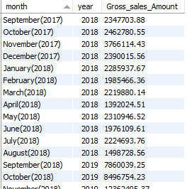
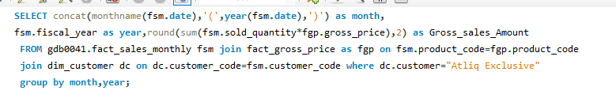
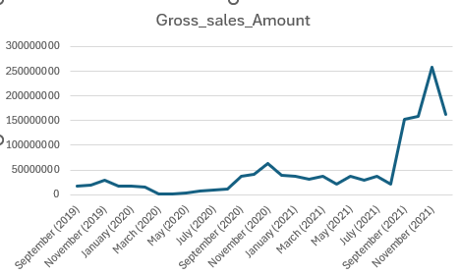
7. Get the complete report of the Gross sales amount for the customer “Atliq Exclusive” for each month. This analysis helps to get an idea of low and high-performing months and take strategic decisions. The final report contains these columns: Month Year Gross sales Amount
Insight
For Atliq Exclusive, November 2020 marked the highest sales, and March 2020 marked the lowest gross sales. It’s very evident that the lower sales between March and August are because of COVID-19. However, it’s a very good sign that the sales increased quickly after August and reached the highest level since the last two years in November.

Slide 13
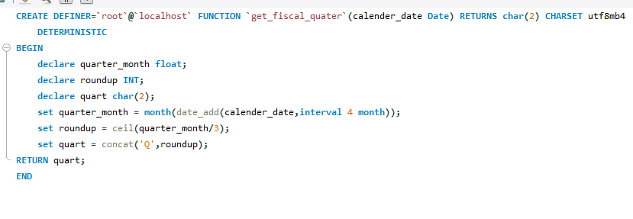
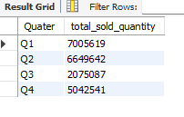
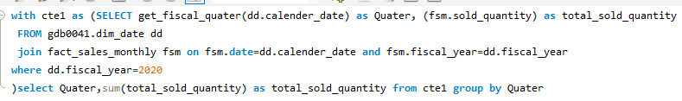
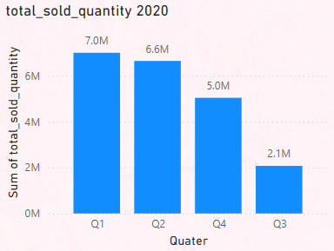
8. In which quarter of 2020, got the maximum total_sold_quantity? The final output contains these fields sorted by the total_sold_quantity, Quarter total_sold_quantity
Insight
Quarter 1 of FY2020 saw the most units sold overall, while Quarter3 had the fewest.
The highest and lowest overall sold quantity is in December and March.
Quarter1 accounts for approximately 34% ofthe total sold quantity for FY2020.

Slide 14
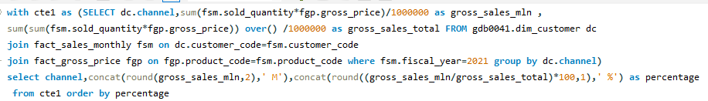
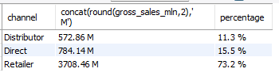
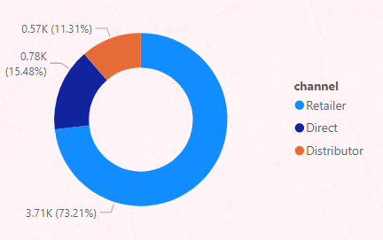
9. Which channel helped to bring more gross sales in the fiscal year 2021 and the percentage of contribution? The final output contains these fields, channel gross_sales_mln percentage
Insight
Channel: "Retailer " helped bring maximum sales to the company with 73.22% as the contribution percentage.
Channel: "Distributor " makes the least contribution at a percentage of11.31%.

Slide 15
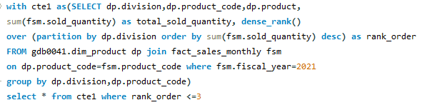
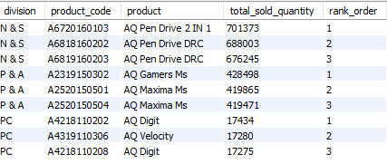
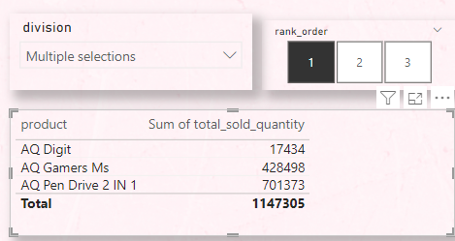
10. Get the Top 3 products in each division that have a high total_sold_quantity in the fiscal_year 2021? The final output contains these fields, division product_code product total_sold_quantity rank_order
Insight
The top 3 selling products in N&S were pen drives, which were around 7 lakh in quantity
The top 3 selling products in P&A were mouse, which were around 4 lakh in quantity.
The top 3 selling products in PC were personal laptops, which were around 17000 in quantity

Slide 16
Thank you

